Slide 2
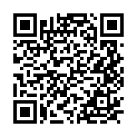
Linkedin: https://www.linkedin.com/in/anand-rao-8aba1b123/
Blog site: https://alwayslearn.in
Community: https://www.meetup.com/azure-aks-chennai-user-group/

Slide 3
Azure Open AI with AKS – Private setup with Firewall and without secrets

Slide 4
Agenda
What is Azure Open AI
Difference between chatgpt and Azure Open AI
Different options to use AI models
Demo on using Azure’s open AI private and calling it from AKS through firewall
Get application code
Self hosted CHATGPT using private Azureopenai

Slide 5
What we are not doing
Not developing any agent
Not installing any llm
not building the application
Not creating a model (ofcourse)

Slide 6
What is Azure Open AI
Azure OpenAI is a service where you can use advanced AI models like gpt4, gpt – 4o via Azure’s cloud and hosted in Azure infrastrucure, similar to how we use Azure Storage, Azure SQL, or AKS.
A good example would be a Azure SQL server managed by Azure where we don’t install the SQL, but it is already installed and available to us with a PAAS model
Similarly the Open AI model is already deployed and optimized in Azure’s infrastructure and available to us. I would call it model as a service.
If we don’t use, Azure’s open AI, the alternate option would be to install OpenAI model on our own infrastructure like VM. This requires massive CPU resources, complex scaling etc.

Slide 7
Why do we really need Azure’s AI when Public AI already exists?
Even though public LLMs like ChatGPT are available, many organizations cannot use them due to security, data privacy, governance, and compliance requirements. This is where Azure AI is considered.
Azure AI provides authentication by integrating with Azure AD, private networking, Data stays within Azure, using managed identities and having complete control
By default chatgpt, uses our data to train the models https://openai.com/policies/how-your-data-is-used-to-improve-model-performance/
Azure AI does not use the data to train models https://learn.microsoft.com/en-us/azure/ai-foundry/responsible-ai/openai/data-privacy?view=foundry-classic&tabs=azure-portal
Integration of RAG based solutions and AI agents is seamless with Azure Open AI

Slide 8
Categories of using models
A model is the LLM or SLM which is brain of AI
A couple of ways to use AI models
  Using public AI platforms like chatgpt
  Self hosted open source models like deepseek, llama which has to be deployed in our own infrastructure like Azure VM or something else which requires massive resources.
  Using the already hosted and managed models in Azure (Azure’s Open AI)

Slide 9
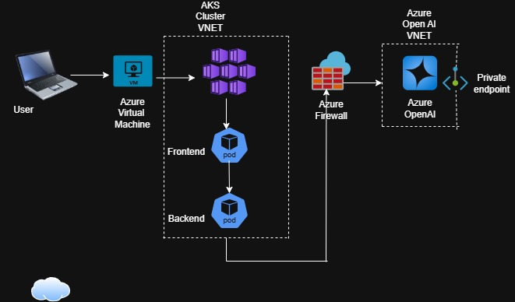
Our setup

Slide 10
Flow
Frontend UI calls backend API which makes a call to Azure’s Open AI through Azure Firewall
Open AI returns answer,
There is no public ip associated with AKS or Azure openAI

Slide 11
Authentication
The AKS’s managed identity should have access to Azure’s OpenAI
The managed identity should be given access at the scope of Azure Foundry
The endpoint url to be used are:
  https://foundryworld.openai.azure.com/
  https://foundryworld.cognitiveservices.azure.com/
The code should be using defaultazurecredential
    credential = DefaultAzureCredential()

Slide 12
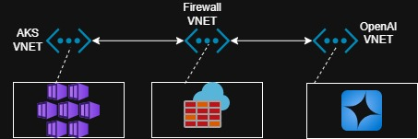
Network Setup
The AKS Cluster is in separate vnet and peered with Firewall VNET
The Open AI is in separate VNET and is peered with firewall VNET\
Firewall rules to be opened from AKS to Azure Open AI
There is a route table associated to the AKS Subnet to route all traffic to the firewall

Slide 13
Using Azure’s Open AI model : Our setup
A chatgpt like application completely private which uses Azure Open AI to reach models and get answers for our queries.
The API calls and frontend UI is hosted on AKS and the API calls are basically made from AKS to Open AI.
We are going to make use of managed Open AI in Azure and call them using the endpoint
We will have a backend python code that makes an API call to the Azure managed AI endpoint. This code will be hosted on top of AKS.
We will have a frontend UI that calls the backend .
The backend API calls the AzureOpenAI

Slide 14
github url to build app and host it in aks
anandazaugust/openai at azdevchennaicommunity

Slide 15
Backup

Slide 16
AzureDiagnostics
| where Category == "AzureFirewallApplicationRule"
| where msg_s contains "Deny"

Slide 17
Flow
az aks get-credentials --resource-group testrg --name aks-cluster-1
az aks get-credentials --resource-group testrg --name aks-cluster-1

Slide 18
Upython3 import redis from azure.identity import DefaultAzureCredential host = "aiforredis.uksouth.redis.azure.net" port = 10000 cred = DefaultAzureCredential() token = cred.get_token("https://redis.azure.com/.default").token r = redis.Redis( host=host, port=port, ssl=True, username="$managed", password=token, decode_responses=True
) print(r.keys("*")) r.delete("chat-1764292527742") sing Azure’s Open AI model

